Slide 1
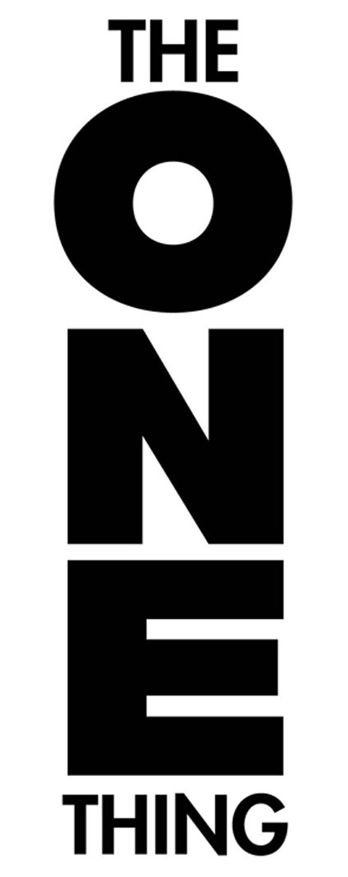
The ONE Thing By Gary Keller
To join our WhatsApp group, open the link given below on phone:
https://chat.whatsapp.com/Gta8r5Mj2Qs5LbsUIAfaEa

Slide 2
IF YOU CHASE TWO RABBITS...
... YOU WILL NOT CATCH EITHER ONE.
- RUSSIAN PROVERB

Slide 3
GOING SMALL
If everyone has the same number of hours in a day, why do some people seem to get so much more done than others? How do they do more, achieve more, earn more, have more? If time is the currency of achievement, then why are some able to cash in their allotment for more chips than others? The answer is they make getting to the heart of things the heart of their approach. They go small.
Going small is a simple approach to extraordinary results, and it works. It works all the time, anywhere and on anything. Why? Because it has only one purpose—to ultimately get you to the point.
When you go as small as possible, you’ll be staring at one thing. And that’s the point.
“Be like a postage stamp — stick to one thing until you get there.” —Josh Billings

Slide 4
THE DOMINO EFFECT
In Leeuwarden, The Netherlands, on Domino Day, November 13, 2009, Weijers Domino Productions coordinated the world record domino fall by lining up more than 4,491,863 dominoes in a dazzling display In this instance, a single domino set in motion a domino fall that cumulatively unleashed more than 94,000 joules of energy, which is as much energy as it takes for an average-sized male to do 545 pushups.
Each standing domino represents a small amount of potential energy; the more you line up, the more potential energy you’ve accumulated. Line up enough and, with a simple flick, you can start a chain reaction of surprising power. And Weijers Domino Productions proved it. When one thing, the right thing, is set in motion, it can topple many things. And that’s not all. In 1983, Lorne Whitehead wrote in the American Journal of Physics that he’d discovered that domino falls could not only topple many things, they could also topple bigger things. He described how a single domino is capable of bringing down another domino that is actually 50 percent larger.
A geometric progression is like a long, long train — it starts out too slow to notice until it’s moving too fast to stop.
Do you see the implication? Not only can one knock over others but also others that are successively larger. In 2001 a physicist from San Francisco’s Exploratorium reproduced Whitehead’s experiment by creating eight dominoes out of plywood, each of which was 50 percent larger than the one before. The first was a mere two inches, the last almost three feet tall. The resulting domino fall began with a gentle tick and quickly ended “with a loud SLAM.” Imagine what would happen if this kept going. If a regular domino fall is a linear progression, Whitehead’s would be described as a geometric progression. The result could defy the imagination. The 10th domino would be almost as tall as NFL quarterback Peyton Manning. By the 18th, you’re looking at a domino that would rival the Leaning Tower of Pisa. The 23rd domino would tower over the Eiffel Tower and the 31st domino would loom over Mount Everest by almost 3,000 feet. Number 57 would practically bridge the distance between the earth and the moon!

Slide 5
GETTING EXTRAORDINARY RESULTS
So when you think about success, shoot for the moon. The moon is reachable if you prioritize everything and put all of your energy into accomplishing the most important thing. Getting extraordinary results is all about creating a domino effect in your life. Toppling dominoes is pretty straightforward. You line them up and tip over the first one. In the real world, though, it’s a bit more complicated. The challenge is that life doesn’t line everything up for us and say, “Here’s where you should start.” Highly successful people know this. So every day they line up their priorities anew, find the lead domino, and whack away at it until it falls.
Why does this approach work? Because extraordinary success is sequential, not simultaneous. What starts out linear becomes geometric. You do the right thing and then you do the next right thing. Over time it adds up, and the geometric potential of success is unleashed. The domino effect applies to the big picture, like your work or your business, and it applies to the smallest moment in each day when you’re trying to decide what to do next. Success builds on success, and as this happens, over and over, you move toward the highest success possible.
When you see someone who has a lot of knowledge, they learned it over time. When you see someone who has a lot of skills, they developed them over time. When you see someone who has done a lot, they accomplished it over time. When you see someone who has a lot of money, they earned it over time.
The key is over time. Success is built sequentially. It’s one thing at a time.

Slide 6
"The ONE Thing" Concept In The Business World
The list of businesses that have achieved extraordinary results through the power of the ONE Thing is endless. Sometimes what is made or delivered is also what is sold, sometimes not. Take Google. Their ONE Thing is search, which makes selling advertising, its key source of revenue, possible. And what about Star Wars? Is the ONE Thing movies or merchandise? If you guessed merchandise, you’d be right— and you’d be wrong. Revenue from toys recently totaled over $10 billion, while combined worldwide box office revenue for the six main films totaled less than half that, $4.3 billion. From where I sit, movies are the ONE Thing because they make the toys and products possible.
The answer isn’t always clear, but that doesn’t make finding it any less important. Technological innovations, cultural shifts, and competitive forces will often dictate that a business’s ONE Thing evolve or transform. The most successful companies know this and are always asking: “What’s our ONE Thing?”
Apple is a study in creating an environment where an extraordinary ONE Thing can exist while transitioning to another extraordinary ONE Thing. From 1998 to 2012, Apple’s ONE Thing moved from Macs to iMacs to iTunes to iPods to iPhones, with the iPad already jockeying for the pole position at the head of the product line. As each new “golden gadget” entered the limelight, the other products weren’t discontinued or relegated to the discount tables. Those lines, plus others, continued to be refined while the current ONE Thing created a well-documented halo effect, making the user more likely to adopt the whole Apple product family.
When you get the ONE Thing, you begin to see the business world differently If today your company doesn’t know what its ONE Thing is, then the company’s ONE Thing is to find out.
“There can only be one most important thing. Many things may be important, but only one can be the most important.” —Ross Garber

Slide 7
ONE PERSON
The ONE Thing is a dominant theme that shows up in different ways. Take the concept and apply it to people, and you’ll see where one person makes all the difference. As a freshman in high school, Walt Disney took night courses at the Chicago Art Institute and became the cartoonist for his school newspaper. After graduation, he wanted to be a newspaper cartoonist but couldn’t get a job, so his brother Roy, a businessman and banker, got him work at an art studio. It was there he learned animation and began creating animated cartoons. When Walt was young, his one person was Roy.
For Sam Walton, early on it was L. S. Robson, his father-inlaw,
who loaned him the $20,000 he needed to start his first retail
business, a Ben Franklin franchise store. Then, when Sam was
opening his first Wal-Mart, Robson secretly paid a landlord
$20,000 to provide a pivotal expansion lease.
Albert Einstein had Max Talmud, his first mentor. It was Max
who introduced a ten-year-old Einstein to key texts in math,
www.drzaban.com
science, and philosophy. Max took one meal a week with the
Einstein family for six years while guiding young Albert.
No one is self-made.
Oprah Winfrey credits her father, and the time she spent with
him and his wife, for “saving” her. She told Jill Nelson of The
Washington Post Magazine, “If I hadn’t been sent to my father, I
would have gone in another direction.” Professionally, it started
with Jeffrey D. Jacobs, the “lawyer, agent, manager and financial
adviser” who, when Oprah was looking for employment contract
advice, persuaded her to establish her own company rather than
simply be a talent for hire. Harpo Productions, Inc., was born.
The world is familiar with the influence that John Lennon and
Paul McCartney had on each other’s songwriting success, but in
the recording studio there was George Martin. Considered one of
the greatest record producers of all time, George has often been
referred to as the “Fifth Beatle” for his extensive involvement on
the Beatles’ original albums. Martin’s musical expertise helped fill
the gaps between the Beatles’ raw talent and the sound they wanted
to achieve. Most of the Beatles’ orchestral arrangements and
instrumentation, as well as numerous keyboard parts on the early
records, were written or performed by Martin in collaboration with
the band.
Everyone has one person who either means the most to them
www.drzaban.com
“You must be singleminded.
Drive for the one
thing on which you have
decided.”
—General George S. Patton
or was the first to influence, train, or manage them.
No one succeeds alone. No one.

Slide 8
THE SIX LIES BETWEEN YOU AND SUCCESS
1. Everything Matters Equally
2. Multitasking
www.drzaban.com
3. A Disciplined Life
4. Willpower Is Always on Will-Call
5. A Balanced Life
6. Big Is Bad

Slide 9
1. Everything Matters Equally
“Things which matter most
must never be at the
mercy of things which
matter least.”
—Johann Wolfgang von Goethe

Slide 10
Equality is a lie.
Understanding this is the basis of all great decisions.
So, how do you decide? When you have a lot to get done in
the day, how do you decide what to do first? As kids, we mostly
did things we needed to do when it was time to do them. It’s
breakfast time. It’s time to go to school, time to do homework,
time to do chores, bath time, bedtime. Then, as we got older, we
were given a measure of discretion. You can go out and play as

Slide 11
long as you get your homework done before dinner. Later, as we
became adults, everything became discretionary. It all became our
choice. And when our lives are defined by our choices, the allimportant
question becomes, How do we make good ones?
Complicating matters, the older we get, it seems there is more
and more piled on that we believe “simply must get done.”
Overbooked, overextended, and overcommitted. “In the weeds”
overwhelmingly becomes our collective condition.
That’s when the battle for the right of way gets fierce and
frantic. Lacking a clear formula for making decisions, we get
reactive and fall back on familiar, comfortable ways to decide what
to do. As a result, we haphazardly select approaches that
undermine our success. Pinballing through our day like a confused
character in a B-horror movie, we end up running up the stairs
instead of out the front door. The best decision gets traded for any
decision, and what should be progress simply becomes a trap.
When everything feels urgent and important, everything
seems equal. We become active and busy, but this doesn’t actually
move us any closer to success. Activity is often unrelated to

Slide 12
While to-dos serve as a useful collection of our best
intentions, they also tyrannize us with trivial, unimportant stuff that
we feel obligated to get done—because it’s on our list. Which is
why most of us have a love-hate relationship with our to-dos. If
allowed, they set our priorities the same way an inbox can dictate
our day. Most inboxes overflow with unimportant e-mails
www.drzaban.com
masquerading as priorities. Tackling these tasks in the order we
receive them is behaving as if the squeaky wheel immediately
deserves the grease. But, as Australian prime minister Bob Hawke
duly noted, “The things which are most important don’t always
scream the loudest.”
Achievers operate differently. They have an eye for the
essential. They pause just long enough to decide what matters and
then allow what matters to drive their day. Achievers do sooner
what others plan to do later and defer, perhaps indefinitely, what
others do sooner. The difference isn’t in intent, but in right of way.
Achievers always work from a clear sense of priority.
Le

Slide 13
Pareto’s Principle, it turns out, is as real as the law of gravity,
www.drzaban.com
and yet most people fail to see the gravity of it. It’s not just a
theory—it is a provable, predictable certainty of nature and one of
the greatest productivity truths ever discovered. Richard Koch, in
his book The 80/20 Principle, defined it about as well as anyone:
“The 80/20 Principle asserts that a minority of causes, inputs, or
effort usually lead to a majority of the results, outputs, or
rewards.” In other words, in the world of success, things aren’t
equal. A small amount of causes creates most of the results. Just
the right input creates most of the output. Selected effort creates
almost all of the rewards.
FIG. 3 The 80/20 Principle says the minority of your effort leads to the
majority of your results.
Pareto points us in a very clear direction: the majority of what
you want will come from the minority of what you do.
Extraordinary results are disproportionately created by fewer
www.drzaban.com
actions than most realize.
Don’t get hung up on the numbers. Pareto’s truth is about
inequality, and though often stated as an 80/20 ratio, it can actually
take a variety of proportions. Depending on the circumstances, it
can easily play out as, say, 90/20, where 90 percent of your success
comes from 20 percent of your effort. Or 70/10 or 65/5. But
understand that these are all fundamentally working off the same
principle. Juran’s great insight was that not everything matters
equally; some things matter more than others—a lot more. A to-do
list becomes a success list when you apply Pareto’s Principle to it.

Slide 14
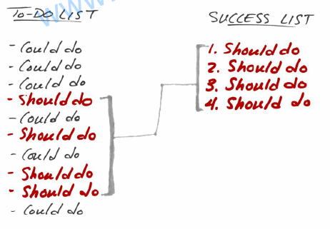
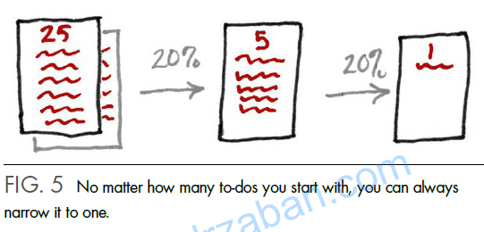

Slide 15
Don’t get trapped in the “check off” game. If we believe
things don’t matter equally, we must act accordingly. We can’t
fall prey to the notion that everything has to be done, that
checking things off our list is what success is all about. We
can’t be trapped in a game of “check off” that never produces
a winner. The truth is that things don’t matter equally and
success is found in doing what matters most.

Slide 16
On “Multitasking”
“To do two things at once
is to do neither.”
—Publilius Syrus

Slide 17
So, if doing the most important
thing is the most important thing,
why would you try to do
anything else at the same time?
It’s a great question.
In the summer of 2009, Clifford Nass set out to answer just
that. His mission? To find out how well so-called multitaskers
multitasked. Nass, a professor at Stanford University, told the New
York Times that he had been “in awe” of multitaskers and deemed
himself to be a poor one. So he and his team of researchers gave
262 students questionnaires to determine how often they
multitasked. They divided their test subjects into two groups of
high and low multitaskers and began with the presumption that the
frequent multitaskers would perform better. They were wrong.
“I was sure they had some secret ability” said Nass. “But it
turns out that high multitaskers are suckers for irrelevancy.” They
were outperformed on every measure. Although they’d convinced
themselves and the world that they were great at it, there was just
one problem. To quote Nass, “Multitaskers were just lousy at
everything.”
Multitasking is a lie.

Slide 18
“Multitasking is merely
the opportunity to screw
up more than one thing at
a time.”
—Steve Uzzell

Slide 19
People can actually do two or more things at once, such as
walk and talk, or chew gum and read a map; but, like computers,
what we can’t do is focus on two things at once. Our attention
bounces back and forth. This is fine for computers, but it has
serious repercussions in humans. Two airliners are cleared to land
on the same runway. A patient is given the wrong medicine. A
toddler is left unattended in the bathtub. What all these potential
tragedies share is that people are trying to do too many things at
www.drzaban.com
once and forget to do something they should do.
It’s strange, but somehow over time the image of the modern
human has become one of a multitasker. We think we can, so we
think we should. Kids studying while texting, listening to music, or
watching television. Adults driving while talking on the phone,
eating, applying makeup, or even shaving. Doing something in one
room while talking to someone in the next. Smartphones in hands
before napkins hit laps. It’s not that we have too little time to do all
the things we need to do, it’s that we feel the need to do too many
things in the time we have. So we double a

Slide 20
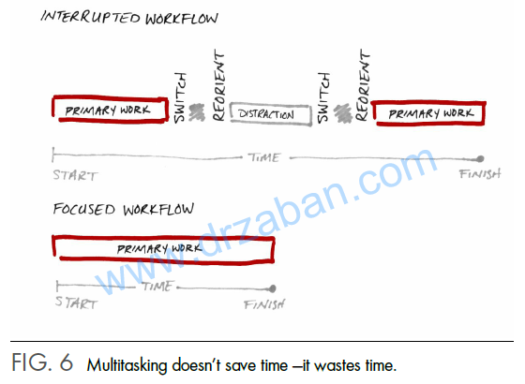

Slide 21
Every time we try to do two or more things at once, we’re
simply dividing up our focus and dumbing down all of the
outcomes in the process. Here’s the short list of how multitasking
short-circuits us:
1. There is just so much brain capability at any one time. Divide
it up as much as you want, but you’ll pay a price in time and
effectiveness.
2. The more time you spend switched to another task, the less
likely you are to get back to your original task. This is how
loose ends pile up.
3. Bounce between one activity and another and you lose time as
your brain reorients to the new task. Those milliseconds add
up. Researchers estimate we lose 28 percent of an average
workday to multitasking ineffectiveness.
4. Chronic multitaskers develop a distorted sense of how long it
takes to do things. They almost always believe tasks take
longer to complete than is actually required.
www.drzaban.com
5. Multitaskers make more mistakes than non-multitaskers. They
often make poorer decisions because they favor new
information over old, even if the older information is more
valuable.
6. Multitaskers experience more life-reducing, happinesssquelching
stress.

Slide 22
BIG IDEAS
1. Distraction is natural. Don’t feel bad when you get
distracted. Everyone gets distracted.
2. Multitasking takes a toll. At home or at work, distractions
lead to poor choices, painful mistakes, and unnecessary stress.
www.drzaban.com
3. Distraction undermines results. When you try to do too much
at once, you can end up doing nothing well. Figure out what
matters most in the moment and give it your undivided
attention.

Slide 23
A DISCIPLINED LIFE
There is this pervasive idea that
the successful person is the
“disciplined person” who leads a
“disciplined life.”
It’s a lie.
The truth is we don’t need
any more discipline than we already have. We just need to direct
and manage it a little better.
Contrary to what most people believe, success is not a
marathon of disciplined action. Achievement doesn’t require you
to be a full-time disciplined person where your every action is
trained and where control is the solution to every situation.
Success is actually a short race—a sprint fueled by discipline just
long enough for habit to kick in and take over.
When we know something that needs to be done but isn’t
currently getting done, we often say, “I just need more discipline.”
Actually, we need the habit of doing it. And we need just enough
discipline to build the habit.
In any discussion about success, the words “discipline” and
“habit” ultimately intersect. Though separate in meaning, they
powerfully connect to form the foundation for achievement—
www.drzaban.com
regularly working at something until it regularly works for you.
When you discipline yourself, you’re essentially training yourself
to act in a specific way. Stay with this long enough and it becomes
routine—in other words, a habit. So when you see people who
look like “disciplined” people, what you’re really seeing is people
who’ve trained a handful of habits into their lives. This makes
them seem “disciplined” when actually they’re not. No one is.

Slide 24
SELECTED DISCIPLINE WORKS SWIMMINGLY
Olympic swimmer Michael Phelps is a case study of selected
discipline. When he was diagnosed with ADHD as a child, his
kindergarten teacher told his mother, “Michael can’t sit still.
Michael can’t be quiet... . He’s not gifted. Your son will never be
able to focus on anything.” Bob Bowman, his coach since age 11,
reports that Michael spent a lot of time on the side of the pool by
the lifeguard stand for disruptive behavior. That same misbehavior
has cropped up from time to time in his adult life as well.
Yet, he’s set dozens of world records. In 2004 he won six gold
and two bronze medals in Athens and then, in 2008, a record eight
in Beijing, surpassing the legendary Mark Spitz. His 18 gold medals
set a record for Olympians in any sport. Before he hung up his
goggles in retirement, his wins at the 2012 London Olympic Games
brought his total medal count to 22 and earned him the status of
most-decorated Olympian in any sport in history. Talking about
Phelps, one reporter said, “If he were a country he’d be ranked
12th over the last three Olympics.” Today, his mom reports,
“Michael’s ability to focus amazes me.” Bowman calls it “his
strongest attribute.” How did this happen? How did the boy who
would “never be able to focus on anything” achieve so much?
Phelps became a person of selected discipline.
www.drzaban.com
From age 14 through the Beijing Olympics, Phelps trained
seven days a week, 365 days a year. He figured that by training on
Sundays he got a 52-training-day advantage on the competition. He
spent up to six hours in the water each day. “Channeling his energy
is one of his great strengths,” said Bowman. Not to oversimplify,
but it’s not a stretch to say that Phelps channeled all of his energy
into one discipline that developed into one habit—swimming daily.
The payoff from developing the right habit is pretty obvious.
It gets you the success you’re searching for. What sometimes gets
overlooked, however, is an amazing windfall: it also simplifies
your life. Your life gets clearer and less complicated because you
know what you have to do well and you know what you don’t.
The fact of the matter is that aiming discipline at the right habit
gives you license to be less disciplined in other areas. When you
do the right thing, it can liberate you from having to monitor
everything.
Michael Phelps found his sweet spot in the swimming pool.
Over time, finding the discipline to do this formed the habit that
changed his life.

Slide 25
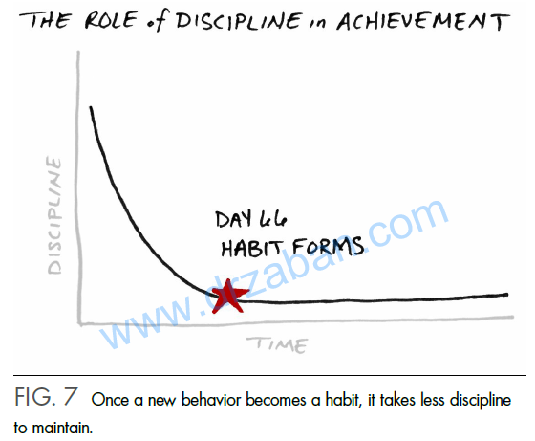

Slide 26
TODDLER TORTURE
In the late ’60s and early ’70s, researcher Walter Mischel began
methodically tormenting four-year-olds at Stanford University’s
Bing Nursery School. More than 500 children were volunteered for
the diabolical program by their own parents, many of whom
would later, like millions of others, laugh mercilessly at videos of
the squirming, miserable kids. The devilish experiment was called
“The Marshmallow Test.” It was an interesting way to look at
willpower.
Kids were offered one of three treats—a pretzel, a cookie, or
the now infamous marshmallow. The child was told that the
researcher had to step away, and if he could wait 15 minutes until
the researcher returned, he’d be awarded a second treat. One treat
now or two later. (Mischel knew they’d designed the test well
when a few of the kids wanted to quit as soon as they explained
the ground rules.)
www.drzaban.com
Left alone with a marshmallow they couldn’t eat, kids
engaged in all kinds of delay strategies, from closing their eyes,
pulling their own hair, and turning away, to hovering over,
smelling, and even caressing their treats. On average, kids held out
less than three minutes. And only three out of ten managed to
delay their gratification until the researcher returned. It was pretty
apparent most kids struggled with delayed gratification. Willpower
was in short supply.
Initially no one assumed anything about what success or
failure in the marshmallow test might say about a child’s future.
That insight came about organically. Mischel’s three daughters
attended Bing Nursery School, and over the next few years, he
slowly began to see a pattern when he’d ask them about classmates
who had participated in the experiment. Children who had
successfully waited for the second treat seemed to be doing better.
A lot better.
Starting in 1981, Mischel began systematically tracking down
the original subjects. He requested transcripts, compiled records,
and mailed questionnaires in an attempt to measure their relative
academic and social progress. His hunch was correct—willpower
or the ability to delay gratification was a huge indicator of future
success. Over the next 30-plus years, Mischel and his colleagues
published numerous papers on how “high delayers” fared better.
Success in the experiment predicted higher general academic
achievement, SAT test scores that were on average 210 points
higher, higher feelings of self-worth, and better stress
management. On the other hand, “low delayers” were 30 percent
more likely to be overweight and later suffered higher rates of
drug addiction. When your mother told you “all good things come
to those who wait,” she wasn’t kidding.

Slide 27
RENEWABLE ENERGY
Think of willpower like the power bar on your cell phone. Every
morning you start out with a full charge. As the day goes on, every
time you draw on it you’re using it up. So as your green bar
shrinks, so does your resolve, and when it eventually goes red,
you’re done. Willpower has a limited battery life but can be
recharged with some downtime.
Stanford University professor Baba Shiv’s research shows just
how fleeting our willpower can be. He divided 165 undergraduate
students into two groups and asked them to memorize either a twodigit
or a seven-digit number. Both tasks were well within the
average person’s cognitive abilities, and they could take as much
time as they needed. When they were ready, students would then
go to another room where they would recall the number. Along the
way, they were offered a snack for participating in the study. The
two choices were chocolate cake or a bowl of fruit salad—guilty
pleasure or healthy treat. Here’s the kicker: students asked to
memorize the seven-digit number were nearly twice as likely to
choose cake. This tiny extra cognitive load was just enough to
prevent a prudent choice.
www.drzaban.com
The implications are staggering. The more we use our mind,
the less minding power we have. Willpower is like a fast-twitch
muscle that gets tired and needs rest. It’s incredibly powerful, but it
has no endurance. As Kathleen Vohs put it in Prevention magazine
in 2009, “Willpower is like gas in your car... . When you resist
something tempting, you use some up. The more you resist, the
emptier your tank gets, until you run out of gas.” In fact, a measly
five extra digits is all it takes to drain our willpower dry.
While decisions tap our willpower, the food we eat is also a
key player in our level of willpower

Slide 28
FOOD FOR THOUGHT
The brain makes up l/50th of our body mass but consumes a
staggering 1/5th of the calories we bum for energy. If your brain
were a car, in terms of gas mileage, it’d be a Hummer. Most of our
conscious activity is happening in our prefrontal cortex, the part of
our brain responsible for focus, handling short-term memory,
solving problems, and moderating impulse control. It’s at the heart
of what makes us human and the center for our executive control
and willpower.
Here’s an interesting fact. The “last in, first out” theory is very
much at work inside our head. The most recent parts of our brain
to develop are the first to suffer if there is a shortage of resources.
Older, more developed areas of the brain, such as those that
www.drzaban.com
regulate breathing and our nervous responses, get first helpings
from our blood stream and are virtually unaffected if we decide to
skip a meal. The prefrontal cortex, on the other hand, feels the
impact. Unfortunately, being relatively young in terms of human
development, it’s the runt of the litter come feeding time.
Advanced research shows us why this matters. A 2007 article
in the Journal of Personality and Social Psychology detailed nine
separate studies on the impact of nutrition and willpower. In one
set, researchers assigned tasks that did or did not involve
willpower and measured blood-sugar levels before and after each
task. Participants who exercised willpower showed a marked drop
in the levels of glucose in the bloodstream. Subsequent studies
showed the impact on performance when two groups completed
one willpower-related task and then did another. Between tasks,
one group was given a glass of Kool-Aid lemonade sweetened
with real sugar (buzz) and the other was given a placebo, lemonade
with Splenda (buzzkill). The placebo group had roughly twice as
many errors on the subsequent test as the sugar group.
The studies concluded that willpower is a mental muscle that
doesn’t bounce back quickly. If you employ it for one task, there
will be less power available for the next unless you refuel. To do
our best, we literally have to feed our minds, which gives new
credence to the old saw, “food for thought.” Foods that elevate
www.drzaban.com
blood sugar evenly over long periods, like complex carbohydrates
and proteins, become the fuel of choice for high-achievers—literal
proof that “you are what you eat.”

Slide 29
COUNTERBALANCING—THE LONG AND SHORT
OF IT
When we say we’re out of balance, we’re usually referring to a
sense that some priorities—things that matter to us—are being
underserved or unmet. The problem is that when you focus on
what is truly important, something will always be underserved. No
matter how hard you try, there will always be things left undone at
the end of your day, week, month, year, and life. Trying to get
them all done is folly. When the things that matter most get done,
you’ll still be left with a sense of things being undone—a sense of
imbalance. Leaving some things undone is a necessary tradeoff for
www.drzaban.com
extraordinary results. But you can’t leave everything undone, and
that’s where counterbalancing comes in. The idea of
counterbalancing is that you never go so far that you can’t find
your way back or stay so long that there is nothing waiting for you
when you return.
This is so important that your very life may hang in the
balance. An 11-year study of nearly 7,100 British civil servants
concluded that habitual long hours can be deadly. Researchers
showed that individuals who worked more than 11 hours a day (a
55-plus hour workweek) were 67 percent more likely to suffer
from heart disease. Counterbalancing is not only about your sense
of well-being, it’s essential to your being well.
There are two types of counterbalancing: the balancing
between work and personal life and the balancing within each. In
the world of professional success, it’s not about how much
overtime you put in; the key ingredient is focused time over time.
To achieve an extraordinary result you must choose what matters
most and give it all the time it demands. This requires getting
extremely out of balance in relation to all other work issues, with
only infrequent counterbalancing to address them. In your
personal world, awareness is the essential ingredient. Awareness of
your spirit and body, awareness of your family and friends,
awareness of your personal needs—none of these can be sacrificed
if you intend to “have a life,” so you can never forsake them for
work or one for the other. You can move back and forth quickly
between these and often even combine the activities around them,
but you can’t neglect any of them for long. Your personal life
requires tight counterbalancing.
Whether or not to go out of balance isn’t really the question.
The question is: “Do you go short or long?” In your personal life,
go short and avoid long periods where you’re out of balance.
Going short lets you stay connected to all the things that matter
most and move them along together. In your professional life, go
long and make peace with the idea that the pursuit of extraordinary
results may require you to be out of balance for long periods.
www.drzaban.com
Going long allows you to focus on what matters most, even at the
expense of other, lesser priorities. In your personal life, nothing
gets left behind. At work it’s required.
In his novel Suzanne’s Diary for Nicholas, James Patterson
artfully highlights where our priorities lie in our personal and
professional balancing act: “Imagine life is a game in which you
are juggling five balls. The balls are called work, family, health,
friends, and integrity. And you’re keeping all of them in the air.
But one day you finally come to understand that work is a rubber
ball. If you drop it, it will bounce back. The other four balls—
family, health, friends, integrity—are made of glass. If you drop
one of these, it will be irrevocably scuffed, nicked, perhaps even
shattered.”

Slide 30
BIG IS BAD
“We are kept from our
goal, not by obstacles but
by a clear path to a lesser
goal.”
—Robert Brault
Big is bad is a lie.

Slide 31
THE BIG DEAL
For more than four decades, Stanford psychologist Carol S.
Dweck has studied the science of how our self-conceptions
influence our actions. Her work offers great insight into why
thinking big is such a big deal.
www.drzaban.com
Dweck’s work with children revealed two mindsets in action
—a “growth” mindset that generally thinks big and seeks growth
and a “fixed” mindset that places artificial limits and avoids failure.
Growth-minded students, as she calls them, employ better learning
strategies, experience less helplessness, exhibit more positive
effort, and achieve more in the classroom than their fixed-minded
peers. They are less likely to place limits on their lives and more
likely to reach for their potential. Dweck points out that mindsets
can and do change. Like any other habit, you set your mind to it
until the right mindset becomes routine.
When Scott Forstall started recruiting talent to his newly
formed team, he warned that the top-secret project would provide
ample opportunities to “make mistakes and struggle, but eventually
we may do something that we’ll remember the rest of our lives.”
He gave this curious pitch to superstars across the company, but
only took those who immediately jumped at the challenge. He was
looking for “growth-minded” people, as he later shared with
Dweck after reading her book. Why is this significant? While
you’ve probably never even heard of Forstall, you’ve certainly
heard of what his team created. Forstall was a senior vice president
at Apple, and the team he formed created the iPhone.

Slide 32
LIFE IS A QUESTION
You may be asking, “Why focus on a question when what we
really crave is an answer?” It’s simple. Answers come from
questions, and the quality of any answer is directly determined by
the quality of the question. Ask the wrong question, get the wrong
answer. Ask the right question, get the right answer. Ask the most
powerful question possible, and the answer can be life altering.
Voltaire once wrote, “Judge a man by his questions rather than
his answers.” Sir Francis Bacon added, “A prudent question is
one-half of wisdom.” Indira Gandhi concluded that “the power to
question is the basis of all human progress.” Great questions are
clearly the quickest path to great answers. Every discoverer and
inventor begins his quest with a transformative question. The
scientific method asks questions of the universe in hypothesis
form. The more than 2,000-year-old Socratic Method, teaching
through questions, is still embraced by educators from the heights
of Harvard Law School to the local kindergarten class. Questions
engage our critical thinking. Research shows that asking questions
improves learning and performance by as much as 150 percent. In
the end, it’s hard to argue with author Nancy Willard, who wrote,
www.drzaban.com
“Sometimes questions are more important than answers.”
I first became aware of the power of questions as a young
man. I read a poem that affected me profoundly and I’ve carried it
with me ever since.
MY WAGE
By J. B. Rittenhouse
I bargained with Life for a penny,
And Life would pay no more,
However I begged at evening
When I counted my scanty store.
For Life is a just employer,
He gives you what you ask,
But once you have set the wages,
Why, you must bear the task.
I worked for a menials hire,
Only to learn, dismayed,
That any wage I had asked of Life,
Life would have willingly paid.
www.drzaban.com
The last two lines deserve repeating: “... any wage I had asked
of Life, Life would have willingly paid.” One of the most
empowering moments of my life came when I realized that life is a
question and how we live it is our answer. How we phrase the
questions we ask ourselves determines the answers that eventually
become our life.
The challenge is that the right question isn’t always so
obvious. Most things we want don’t come with a road map or a set
of instructions, so it can be difficult to frame the right question.
Clarity must come from us. It seems we must envision our own
journeys, make our own maps, and create our own compasses. To
get the answers we seek, we have to invent the right questions—
and we’re left to devise our own. So how do you do this? How do
you come up with uncommon questions that take you to
uncommon answers?
You ask one question: the Focusing Question.
Anyone who dreams of an uncommon life eventually
discovers there is no choice but to seek an uncommon approach to
living it. The Focusing Question is that uncommon approach. In a
world of no instructions, it becomes the simple formula for finding
exceptional answers that lead to extraordinary results.
www.drzaban.com
“What is the one thing I can do such that by doing it everything else will be easier or unnecessary?”

Slide 33
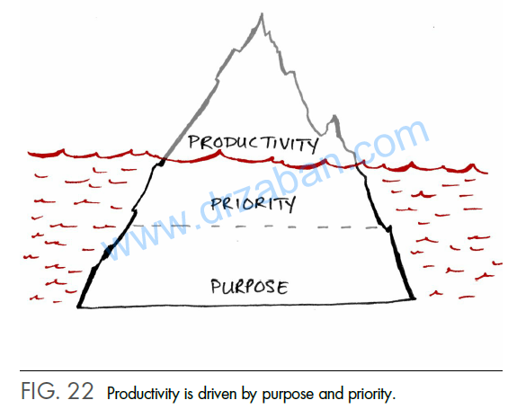
“Even if you’re on the
right track, you’ll get run
over if you just sit there.”
— Will Rogers
Think of purpose, priority, and productivity as three parts of
an iceberg.
With typically only 1/9 of an iceberg above water, whatever
you see is just the tip of everything that is there. This is exactly
how productivity, priority, and purpose are related. What you see is
www.drzaban.com
determined by what you don’t.

Slide 34
THE BEGGING BOWL
Upon coming out of his palace one morning and encountering a
beggar, a king asks, “What do you want?” The beggar laughingly
says, “You ask as though you can fulfill my desire!” Offended, the
king replies, “Of course I can. What is it?” The beggar warns,
“Think twice before you promise anything.”
Now, the beggar was no ordinary beggar but the king’s past-life
master, who had promised in their former life, “I will come to try
and wake you in our next life. This life you have missed, but I will
www.drzaban.com
come again to help you.”
The king, not recognizing his old friend, insisted, “I will fulfill
anything you ask, for I am a very powerful king who can fulfill
any desire.” The beggar said, “It is a very simple desire. Can you
fill this begging bowl?” “Of course!” said the king, and he
instructed his vizier to “fill the man’s begging bowl with money.”
The vizier did, but when the money was poured into the bowl, it
disappeared. So he poured more and more, but the moment he did,
it would disappear.
The begging bowl remained empty.
Word spread throughout the kingdom, and a huge crowd gathered.
The prestige and power of the king were at stake, so he told his
vizier, “If my kingdom is to be lost, I am ready to lose it, but I
cannot be defeated by this beggar.” He continued to empty his
wealth into the bowl. Diamonds, pearls, emeralds. His treasury was
becoming empty.
And yet the begging bowl seemed bottomless. Everything put into
it immediately disappeared!
Finally, as the crowd stood in utter silence, the king dropped at the
beggars feet and admitted defeat. “You are victorious, but before
you go, fulfill my curiosity. What is the secret of this begging
bowl?”
www.drzaban.com
The beggar humbly replied, “There is no secret. It is simply made
up of human desire.”
One of our biggest challenges is making sure our life’s
purpose doesn’t become a beggar’s bowl, a bottomless pit of
desire continually searching for the next thing that will make us
happy. That’s a losing proposition.
Acquiring money and obtaining things are pretty much all
done for the pleasure we expect them to bring. On one hand, this
actually works. Securing money or something we want can spike
our happiness meter—for a moment. Then it goes back down.
Over the ages, our greatest minds have pondered happiness, and
their conclusions are much the same: having money and things
won’t automatically lead to lasting happiness.

Slide 35
FAITH:
“Only those who will risk
going too far can possibly
find out how far one can
go.”
— T. S. Eliot
One evening an elder
Cherokee told his grandson
about a battle that goes on inside
all people. He said, “My son, the
battle is between two wolves
inside us. One is Fear. It carries anxiety, concern, uncertainty,
hesitancy, indecision and inaction. The other is Faith. It brings
calm, conviction, confidence, enthusiasm, decisiveness, excitement
and action.” The grandson thought about it for a moment and then
meekly asked his grandfather: “Which wolf wins?” The old
Cherokee replied, “The one you feed.”
Your journey toward extraordinary results will be built above
all else on faith. It’s only when you have faith in your purpose and
priorities that you’ll seek out your ONE Thing.

Slide 36
YOU ARE THE FIRST DOMINO.
SUCCESS IS AN INSIDE JOB
So, how do you live a life of no regrets? The same way your
journey to extraordinary results begins. With purpose, priority, and
productivity; with the knowledge that regret must be avoided, and
can be; with your ONE Thing at the top of your mind and the top
of your schedule; with a single first step we can all take.
I believe the best way to share this is in a story.
www.drzaban.com
One evening, a young boy hopped up on his father’s lap and
whispered, “Dad, we don’t spend enough time together.” The
father, who dearly loved his son, knew in his heart this was true
and replied, “You’re right and I’m so sorry. But I promise I’ll make
it up to you. Since tomorrow is Saturday, why don’t we spend the
entire day together? Just you and me!” It was a plan, and the boy
went to bed that night with a smile on his face, envisioning the day,
excited about the adventurous possibilities with his Pops.
The next morning the father rose earlier than usual. He
wanted to make sure he could still enjoy his ritual cup of coffee
with the morning paper before his son awoke, wound up and
ready to go. Lost in thought reading the business section, he was
caught by surprise when suddenly his son pulled the newspaper
down and enthusiastically shouted, “Dad, I’m up. Let’s play!”
The father, although thrilled to see his son and eager to start
the day together, found himself guiltily craving just a little more
time to finish his morning routine. Quickly racking his brain, he
hit upon a promising idea. He grabbed his son, gave him a huge
hug, and announced that their first game would be to put a puzzle
together, and when that was done, “we’ll head outside to play for
the rest of the day.”
Earlier in his reading, he had seen a full-page ad with a
picture of the world. He quickly found it, tore it into little pieces,
www.drzaban.com
and spread them out on the table. He found some tape for his son
and said, “I want to see how fast you can put this puzzle together.”
The boy enthusiastically dove right in, while his father, confident
that he had now bought some extra time, buried himself back in
his paper.
Within minutes, the boy once again yanked down his father’s
newspaper and proudly announced, “Dad, I’m done!” The father
was astonished. For what lay in front of him—whole, intact, and
complete—was the picture of the world, back together as it was in
the ad and not one piece out of place. In a voice mixed with
parental pride and wonder, the father asked, “How on earth did
you do that so fast?”
The young boy beamed. “It was easy, Dad! I couldn’t do it at
first and I started to give up, it was so hard. But then I dropped a
piece on the floor, and because it’s a glass-top table, when I looked
up I saw that there was a picture of a man on the other side. That
gave me an idea!
“When I put the man together, the world just fell into place.”
I first heard this innocent narrative when I was a teenager and
I’ve never been able to shake it. It became a tale I continually retell
in my head, and ultimately a central theme in my life. What struck
me isn’t the apparent issue with life balance the father had, though
I certainly got that. What grabbed me and stuck with me was the
www.drzaban.com
inspired solution of the son. He cracked a deeper code: a simple
and more straightforward approach to life. A starting point for any
challenge we face personally or professionally. The ONE Thing we
must all understand if we are to achieve extraordinary results at
our highest level possible. Undoubtedly. Unquestionably.
Success is an inside job.
Put yourself together, and your world falls into place. When
you bring purpose to your life, know your priorities, and achieve
high productivity on the priority that matters most every day, your
life makes sense and the extraordinary becomes possible.
All success in life starts within you. You know what to do.
You know how to do it. Your next step is simple.
You are the first domino.

